Slide 1
User Sign-Up
First Name
Last Name
Mobile no.
Email id
Gender
Address
Password
Sign up as seller
Create
Cancel
Sign up as seller
Create
Cancel

Slide 2
Seller Sign-Up
First Name
Last Name
Mobile no.
Email id
GST no.
Address
Password
Sign up as buyer
Create
Cancel
Sign up as buyer

Slide 3
Logo
Home
Cart
Login
Login
Email
Email
Password
Password
Login
Forget password?
Create new account

Slide 4
Add Item/ Edit Item
Mobile
Product Id
Item Name
Description
CompanyName
Amount
Category
Add Item/ Update
Cancel

Slide 5
Logo
Search
Login
Cart
About-Us
Catagory1
Catagory2
Catagory3
Catagory4
Catagory6
Catagory6
Image(SlidShow)
Products
Footer

Slide 6
Logo
Mily
Home
Cart
User Profile
Mily
Sinah
Edit
Your Order
Gender
Male
Female
milysinah@gmail.com
Edit
Change password
9878765098
Edit

Slide 7
Logo
Mily
Home
Cart
Your Order
List of orders
Price
Delivered / expected date
Product 1 $2312.56 11/02/2050 Friday
Product 1 $2312.56 11/02/2050 Friday
Product 1 $2312.56 11/02/2050 Friday

Slide 8
Logo
Mily
Home
Cart
Cart
Image
Product name
Save for later
Remove
-
1
+
Image
Product name
Save for later
Remove
-
1
+
Place Order

Slide 9
Logo
Mily
Home
Cart
Payment confirmation page
Delivery Address
Order summary
Payment option
Cancel
Place Order

Slide 10
Logo
Admin
Home
Cart
Admin
List of orders
Confirm order
Decline order
Update order
Manage feedback
Add item
Block seller/buyer
Edit item
Report
Delete item

Slide 11
Logo
Seller
Home
Cart
Seller
List of orders
Seller profile
Your item
Your sell
Your amount

Slide 12
Logo
Login
Home
Cart
Product page
Product name
Price
Star
Description
Product photo
Add to cart
Buy

Slide 13
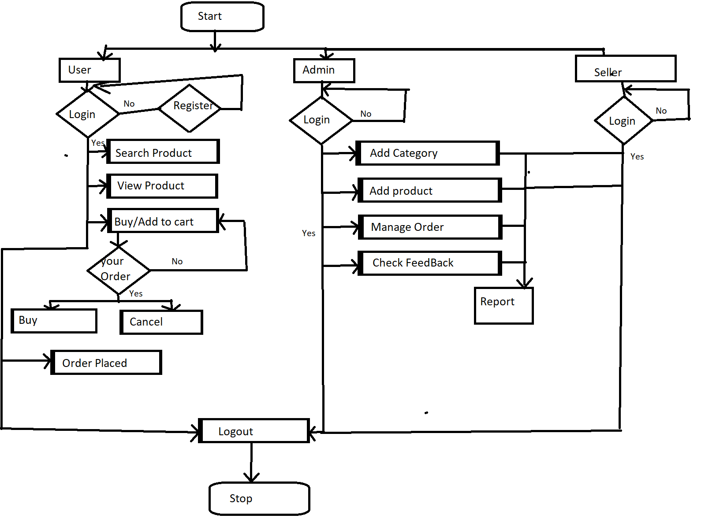

Slide 14
Forgot password?
Email
New Password
Update

Slide 15
Change password
Email
Old Password
New Password
Update

Slide 16
Payment Option
Add Account
Price(1 Item) $xxx.xx
Delivery charge $xx.xx
Amount Payable $xxxx.xx
UPI
Debit/Credit
COD

Slide 17
Add new address
Name
10 digit mobile number
Pincode
Locality
Address(area and street)
City/District/Town
Select state
Landmark(optional)
Alternate Phone no(Optional)
Add and Deliver here
Cancel

